Slide 1
Chapter 4
The Divide-and-Conquer Strategy
4 -<number>

Slide 2
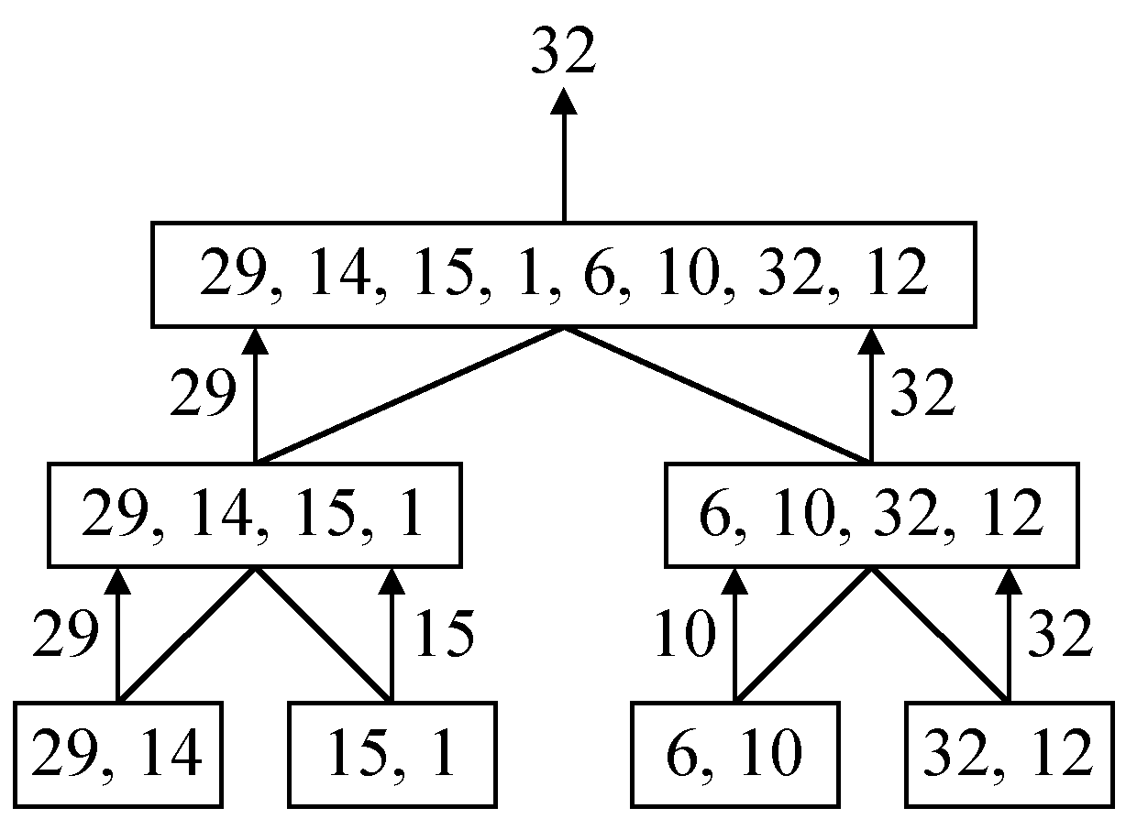
A Simple Example
Finding the maximum of a set S of n numbers
4 -<number>

Slide 3
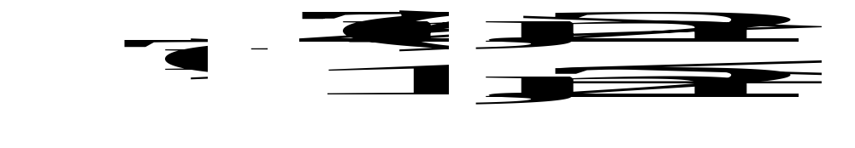
Time Complexity
Time complexity:
Calculation of T(n):
Assume n = 2^{k},
T(n) = 2T(n/2)+1
= 2(2T(n/4)+1)+1
= 4T(n/4)+2+1
:
=2^{k-1}T(2)+2^{k-2}+…+4+2+1
=2^{k-1}+2^{k-2}+…+4+2+1
=2^{k}-1 = n-1
4 -<number>

Slide 4
A General Divide-and-Conquer Algorithm
Step 1: If the problem size is small, solve this problem directly; otherwise, split the original problem into 2 sub-problems with equal sizes.
Step 2: Recursively solve these 2 sub-problems by applying this algorithm.
Step 3: Merge the solutions of the 2 sub- problems into a solution of the original problem.
4 -<number>

Slide 5
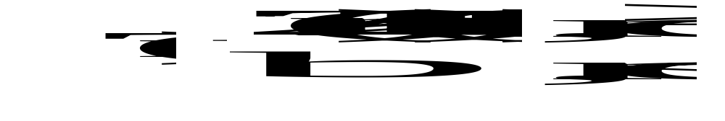
Time Complexity of the General Algorithm
Time complexity:
where S(n) : time for splitting
M(n) : time for merging
b : a constant
c : a constant
4 -<number>

Slide 6
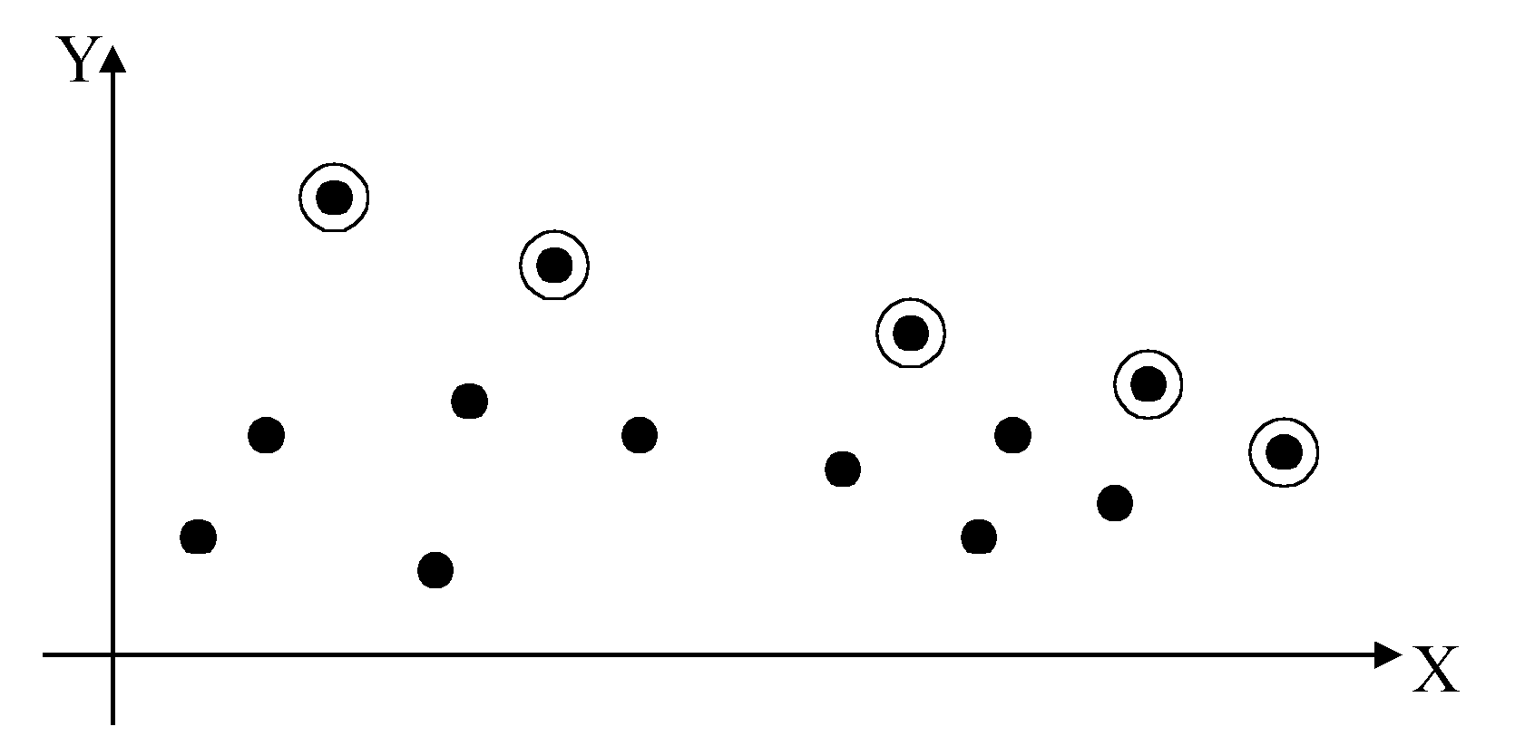
2-D Maxima Finding Problem
Def : A point (x₁, y₁) dominates (x₂, y₂) if x₁ > x₂ and y₁ > y₂. A point is called a maxima if no other point dominates it.
Straightforward method : Compare every pair of points.
Time complexity:
O(n²)
4 -<number>

Slide 7
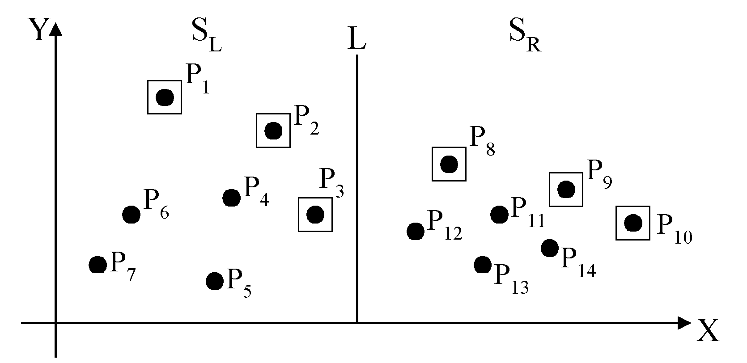
Divide-and-Conquer for Maxima Finding
The maximal points of S_{L} and S_{R}
4 -<number>

Slide 8
The algorithm:
Input: A set S of n planar points.
Output: The maximal points of S.
Step 1: If S contains only one point, return it as the maxima. Otherwise, find a line L perpendicular to the X-axis which separates S into S_{L}and S_{R}, with equal sizes.
Step 2: Recursively find the maximal points of S_{L} and S_{R} .
Step 3: Find the largest y-value of S_{R}, denoted as y_{R}. Discard each of the maximal points of S_{L} if its y-value is less than y_{R}.
4 -<number>

Slide 9
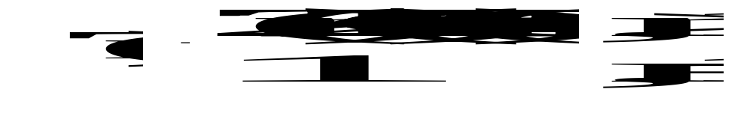
Time complexity: T(n)
Step 1: O(n)
Step 2: 2T(n/2)
Step 3: O(n)
Assume n = 2^{k}
T(n) = O(n log n)
4 -<number>

Slide 10
Maximum Subarray
Input: An array A[1 .. n]. of numbers. Assume that some of the numbers are
negative, because this problem is trivial
when all numbers are nonnegative.
Output: Indices i and j such that A[i..j]. has the greatest sum of any nonempty, contiguous subarray of A, along with the sum of the values in A[i..j].
4 -<number>

Slide 11
Maximum Subarray
Solve it by brute force
C(n,2) subarrays Θ(n²)
Compute the sum of A[i..j] O(n)
Best computation is O(1)
Time complexity is Θ(n²)
4 -<number>

Slide 12
Divide the subarray into two subarrays of as equal size as possible. Find the midpoint mid of the subarrays, and consider the subarrays A[low ..mid] and A[mid+1..high].
Conquer by finding a maximum subarrays of A[low ..mid] and A[mid+1..high].
Combine by finding a maximum subarray that crosses the midpoint, and using the best solution out of the three (the subarray crossing the midpoint and the two solutions found in the conquer step).
4 -<number>

Slide 13
FIND-MAX-CROSSING-SUBARRAY(A, low, mid, high)
// Find a maximum subarray of the form A[i.. mid]
left-sum = - infinite
sum = 0
for i = mid downto low
sum = sum + A[i]
if sum > left-sum
left-sum = sum
max-left = i
// Find a maximum subarray of the form A[mid+1..j]
right-sum = - infinite
sum = 0
for j = mid +1 to hight
sum = sum + A[j]
if sum > light-sum
right-sum = sum
max-right= j
// Return the indices and the sum of the two subarrays.
return (max-left,max-right,left-sum+right-sum)
4 -<number>

Slide 14
FIND-MAXIMUM-SUBARRAY(A, low, high)
if high == low
return (low, high, A[low])
else
mid = (low +high)/2
(left-low,left-high,left-sum)=FIND-MAXIMUM-SUBARRAY (A, low, mid)
(right-low,right-high,right-sum)=FIND-MAXIMUM-SUBARRAY(A, mid+1, high)
(cross-low, cross-high, cross-sum)=FIND-MAX-CROSSING –SUBARRAY(A, low, mid, high)
if left-sum >=right-sum and left-sum >=cross-sum
return (left-low, left-high, left-sum)
else if right-sum>= eft-sum and right-sum>=cross-sum
return (right-low, right-high, right-sum)
else return (cross-low, cross-high, cross-sum)
4 -<number>

Slide 15
T(n) = Θ(1) + 2T(n/2) + Θ(n) + Θ(1)
= 2T(n/2) + Θ(n)
4 -<number>

